Slide 1

Homework Boolean Logic
Iliescu Andrei

Slide 2
Problem statement – Exercise 6.8
Using Quine’s method, simplify the following Boolean functions given in DCF (disjunction of minterms):
f₈(x₁,x₂,x₃)= m₀ ∨ m₂ ∨ m₃ ∨ m₄ ∨ m₅ ∨ m₆

Slide 3
Theoretical results
Let f: (B₂)^{n} → B₂ , n from N* be a Boolean function of n variables.
A monom is a conjuction of variables.
A minterm is a monom which contains all n variables.
A maxterm is a disjuction containing all n variables.
The support of f is the set S_{f} = {(x₁,x₂,x₃)| f(x₁,x₂,x₃) = 1}.
The monom m is smaller or equal than the monom m’ if and only if the support of m is included or equal to the support of m’.
m and m’ are called adjacent monoms if they differ only by the power of one variable. The factorization of the monoms m and m’ is obtained by eliminating the variable that is different.

Slide 4
Theoretical results
Let f: (B₂)^{n} → B₂ , n from N* be a Boolean function of n variables.
The set M(f) is the set of maximal monoms of the function f and contains minterms or monoms obtained by using factorization.
The set C(f) is the set of central monoms of the function f and contains maximal monoms that are not smaller than the disjunction of all the other maximal monoms of f.

Slide 5
Theoretical results
Quine’s Method description(part I):
The first step is to order the support set of f, S_{f} = {(x₁,x₂,x₃)| f(x₁,x₂,x₃) = 1}, in ascending/descending order, with respect to the number of “1” values in each n-uple.
The minterms from the function’s expression are represented using the powers of variables in a tableau, each minterm on a line, in ascending/descending order, with respect to the number of “1” values in the n-uples of the support of the function. The header of the tableau contains the variables’ names.
We make groups of minterms (delimited by horizontal lines), such that all the minterms belonging to the same group have the same number of values “1” as powers of variables. A double Horizontal line marks the end of the representation of the initial function.

Slide 6
Theoretical results
Quine’s Method description(part II):
Only two neighbour groups can contain two adjacent monoms.
The result of the factorization of two adjacent monoms (m and m’) is a new monom represented as a row at the end of the table. The row contains the same values (0, 1 or - ) in the columns corresponding to the common variables (of m and m’) and the symbol “-” for the variable which is eliminated. The rows corresponding to m and m’ are marked (on the left side), with the meaning that they are not maximal monoms.
All the monoms obtained as result of the factorization of two neighbour groups will form a new group, used further in higher order factorizations.

Slide 7
Theoretical results
Quine’s Method description(part III):
The symbol “-” cannot be combined with anything else. Thus, beginning with double factorization only rows from two neighbour groups having “-” on the same position can be combined.
A double horizontal line symbolizes the end of a simple, double triple, … factorization. The end of the factorization process is represented by a triple horizontal line.
The set of maximal monoms contains the monoms corresponding to all the unmarked rows from the table.
For obtaining the central monoms it is used a new table representing the correspondence between the maximal monoms (on columns) and the minterms from the function’s expression (on rows).

Slide 8
Theoretical results
Quine’s Method description(part IV):
A cell in the table is marked with a star (*) if the minterm corresponding to the row was used in factorization to obtain the maximal monom from the column. A maximal monom is a central monom if there is a * (on its column), which is unique on its row. The disjunction of all central monoms belongs to all simplified forms of the initial function.
According to the previous table, the minterms from the function’s expressions which are uncovered by the central monoms will be covered in all possible ways using a minimum number of unused maximal monoms, with a minimum number of overlaps, resulting all simplified forms of the initial function.

Slide 9
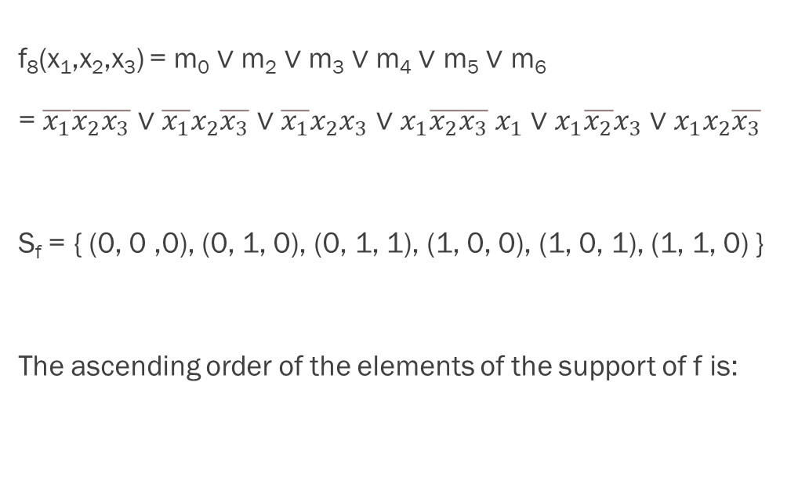
Quine’s Method
f₈(x₁,x₂,x₃) = m₀ ∨ m₂ ∨ m₃ ∨ m₄ ∨ m₅ ∨ m₆
= $\overline{x_{1}}\overline{x_{2}}\overline{x_{3}}$ ∨ $\overline{x_{1}}x_{2}\overline{x_{3}}$ ∨ $\overline{x_{1}}x_{2}x_{3}$ ∨ $x_{1}\overline{x_{2}}\overline{x_{3}}$ $x_{1}$ ∨ $x_{1}\overline{x_{2}}x_{3}$ ∨ $x_{1}x_{2}\overline{x_{3}}$
S_{f} = { (0, 0 ,0), (0, 1, 0), (0, 1, 1), (1, 0, 0), (1, 0, 1), (1, 1, 0) }
The ascending order of the elements of the support of f is:
S_{f} = { (0, 0 ,0), (0, 1, 0), (1, 0, 0), (0, 1, 1), (1, 0, 1), (1, 1, 0) }

Slide 10



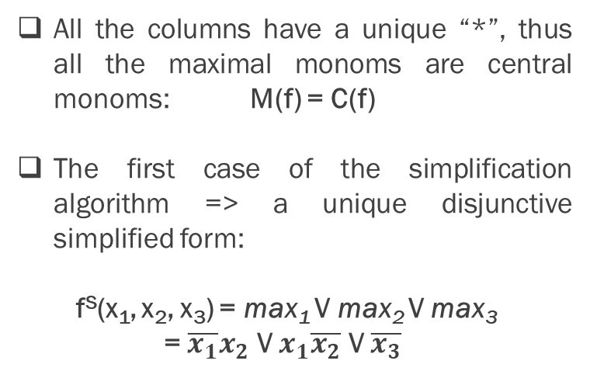

S_{f} = { (0, 0 ,0), (0, 1, 0), (1, 0, 0), (0, 1, 1), (1, 0, 1), (1, 1, 0) }
M(f) = { max₁, max₂, max₃ }
Group
I
II
III
IV = I + II
V = II + III
VI = IV + V
x₁ x₂ x₃
0 0 0
0 1 0 1 0 0
0 1 1 1 0 1 1 1 0
X
m₀
X
m₂
X
m₄
X
m₃
X
m₅
X
m₆
X
0 - 0 - 0 0
0 1 - - 1 0 1 0 - 1 - 0
m₀ V m₂
X
m₀ V m₄
All the columns have a unique “*”, thus all the maximal monoms are central monoms: M(f) = C(f)
The first case of the simplification algorithm => a unique disjunctive simplified form:
f^{S}(x₁, x₂, x₃) = max₁ V max₂ V max₃
= $\overline{x_{1}}x_{2}$ V $x_{1}\overline{x_{2}}$ V $\overline{x_{3}}$
m₂ V m₃ = $\overline{x_{1}}x_{2}$ = max₁
X
m₂ V m₆
m₄ V m₅ = $x_{1}\overline{x_{2}}$ = max₂
X
m₄ V m₆
- - 0 - - 0
m₀ V m₂ V m₄ V m₆ = $\overline{x_{3}}$ = max₃
X
m₀ V m₄ V m₂ V m₆ = $\overline{x_{3}}$
duplicate

Slide 11

Conclusion
f^{S}(x₁, x₂, x₃) = max₁ V max₂ V max₃
= $\overline{x_{1}}x_{2}$ V $x_{1}\overline{x_{2}}$ V $\overline{x_{3}}$

